Slide 1
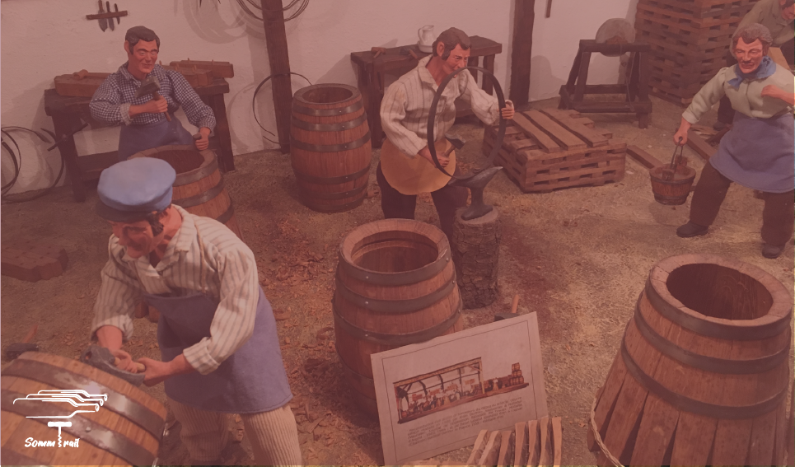
Best Wines to drink
Amanda da Silva Pinto

Slide 2
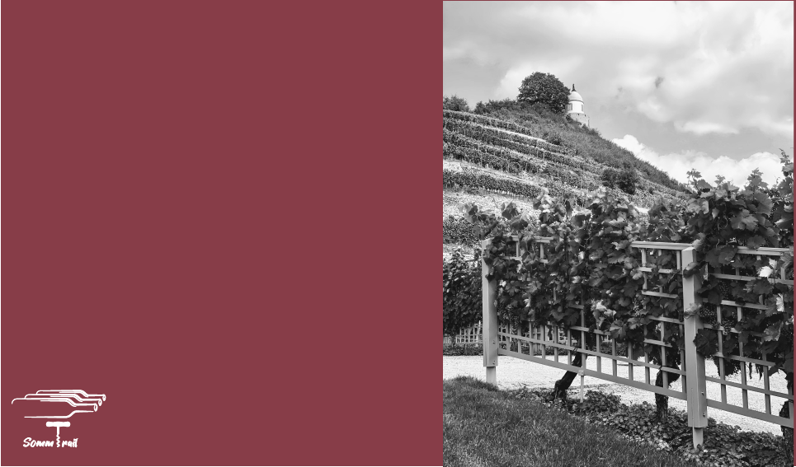
About DataSet
130k Wines Reviews
Rating 80-100
Range of Price 4$ - 3k$
Year 1936 -2017 and NV(Sparkling)
42 Countries
20 Tasters

Slide 3
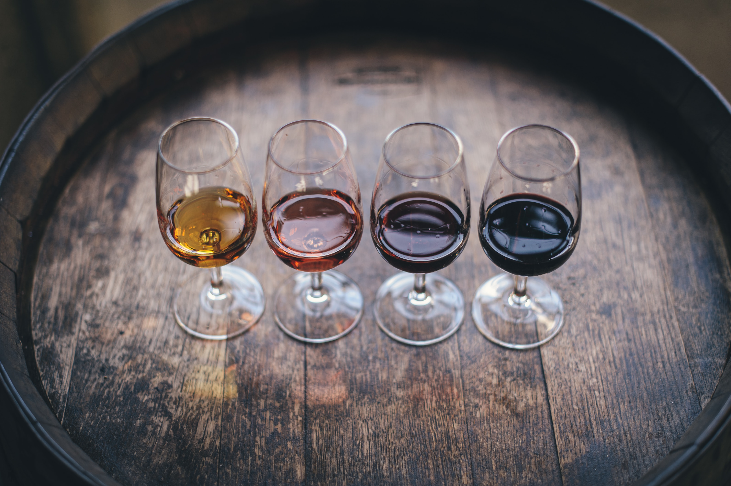
Case
What is the best wine to drink according to Wine Enthusiast?
Best Years to buy bottle
Best Region to look when you buy wine
Best Cheapest Wine
Best Medium Wine
Best Wine with 100 points!

Slide 4
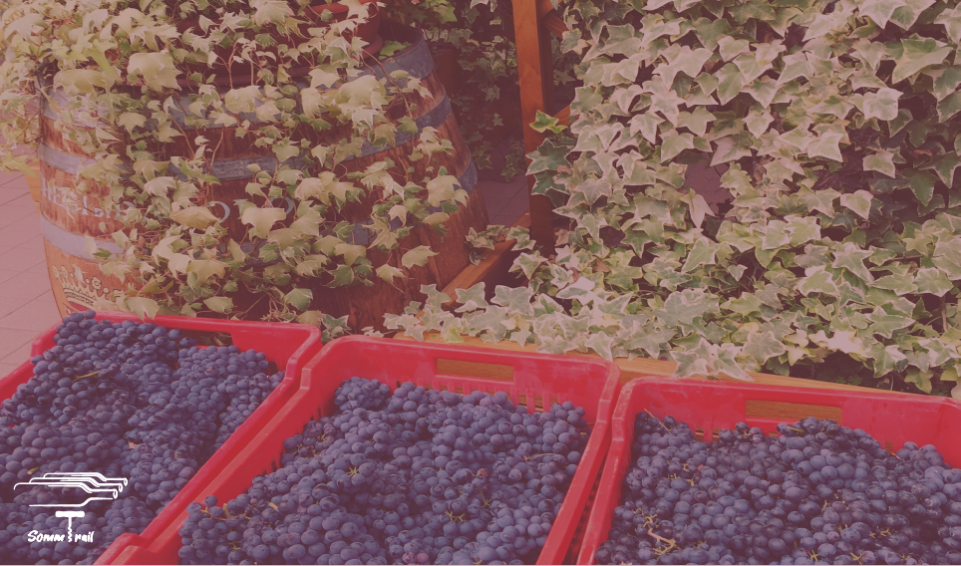
Wine Overview

Slide 5
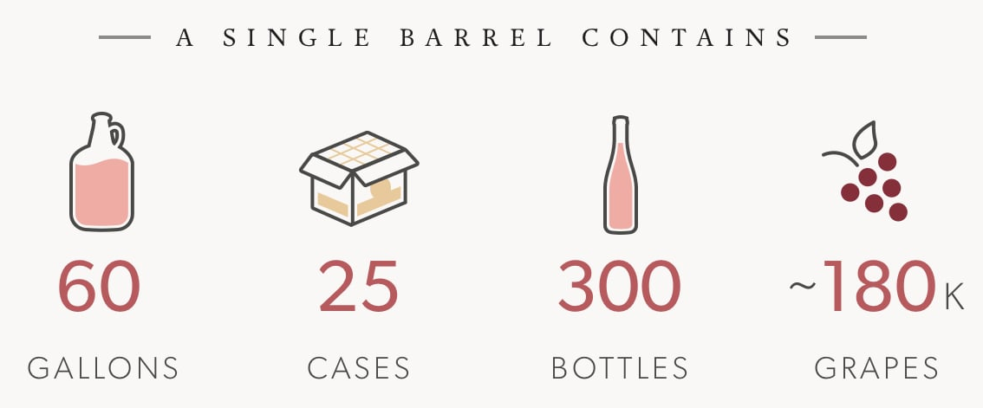
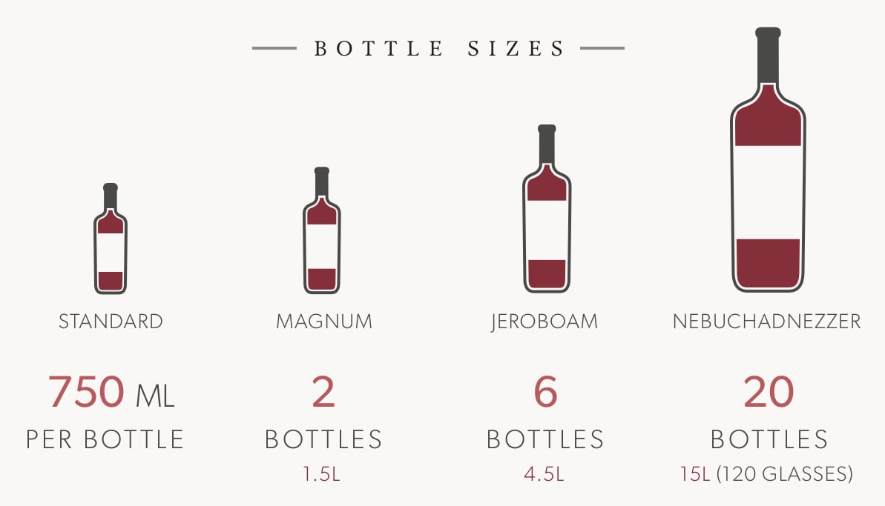
Wine Curiosity

Slide 6
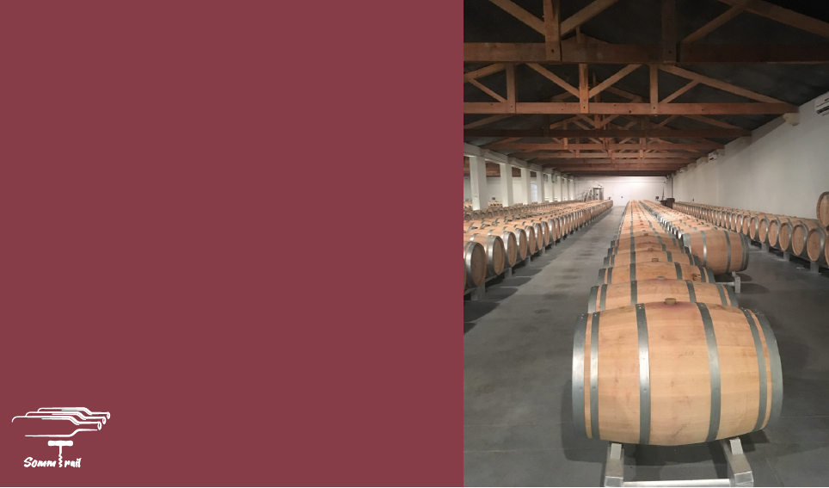




Big Numbers
13% Spain
7.3 mha
Wine Territory
10,9% France
10,7% China
Italy - 49.1
260 mhl
World Production +1%
France - 46.6
Spain - 40.7
USA – 14%
234 mhl
World Consumption -3%
France– 11%
Italy – 10%
UK main importer of Wine
Notes:
7.3 mha area under vines world
13% and 10,9% in spain and France
China 10,7%
260mhl World Wine Production +1%
Italy, France and Spain – 49.1, 46.6, 40.7
234 mhl World Wine consumption -3%
USA, France and Italy – 14%, 11%, 10%
UK main importer of Wine

Slide 7

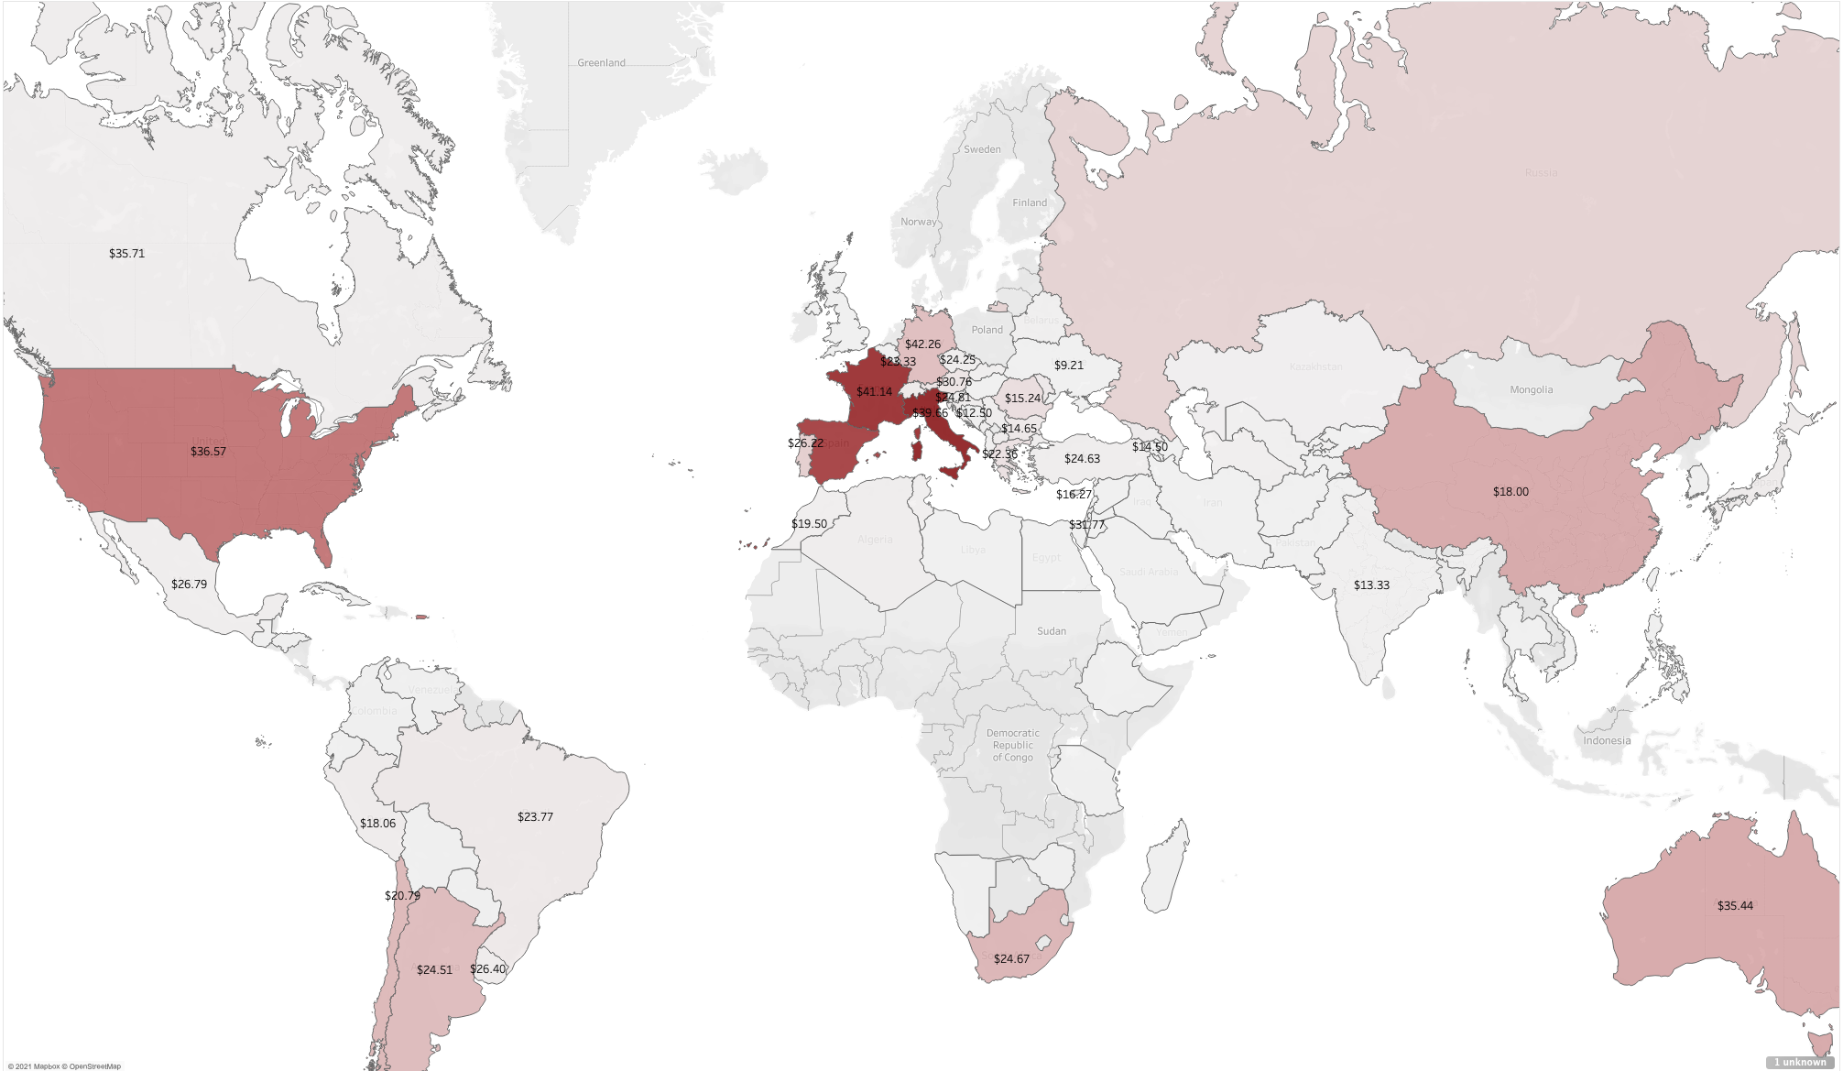
World Production x Average Price

Slide 8
Let’s Dive IN

Slide 9
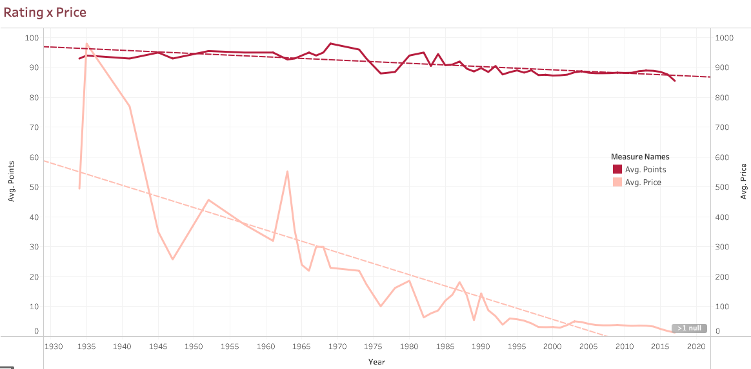
Looking into Price x Rating

Slide 10
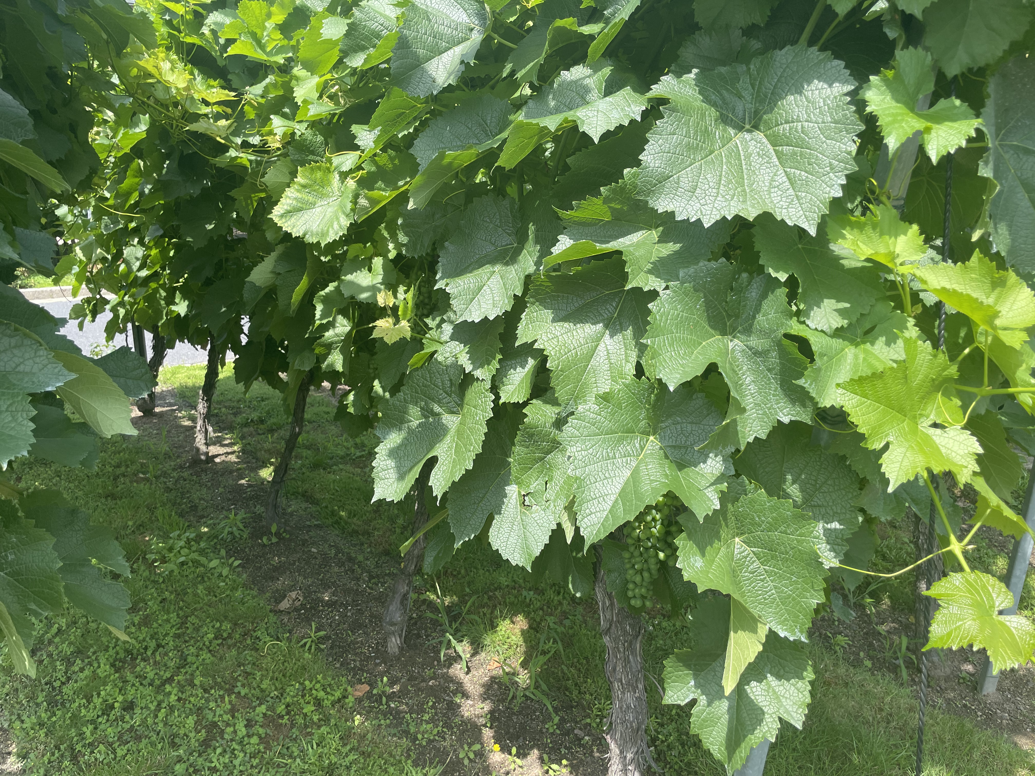
But, ok… So How Can I Choose my Wine?

Slide 11
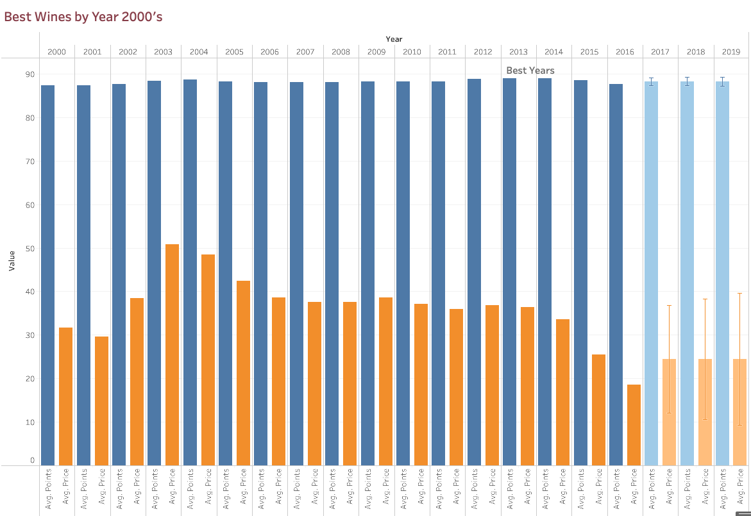
Than you can choose a year…

Slide 12
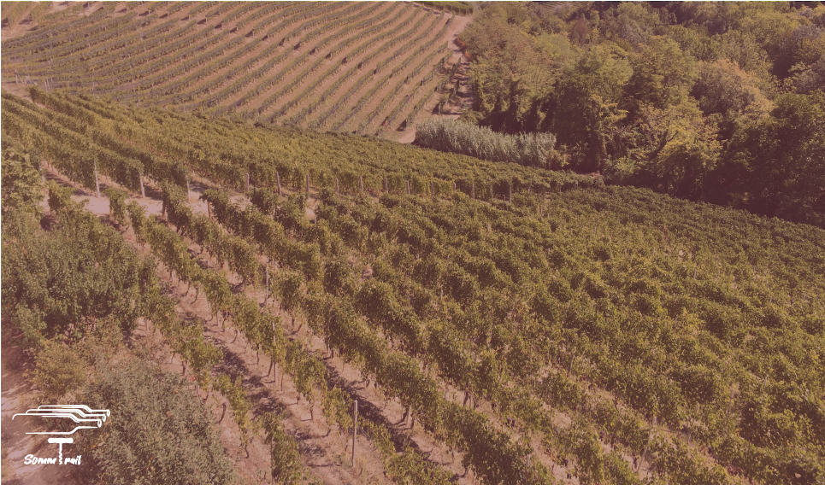
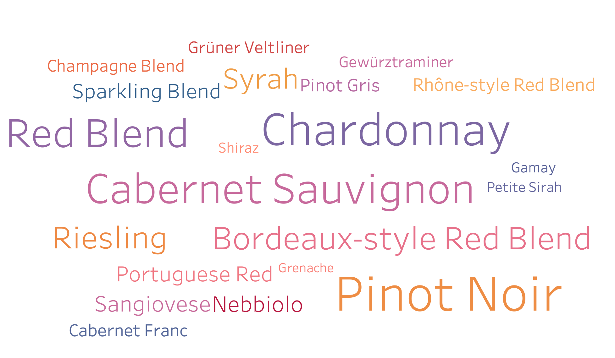
First you can choose your grape…
+ 12K types of Grapes
– Divided By Wine Types, Table Wine and Eating Grapes

Slide 13
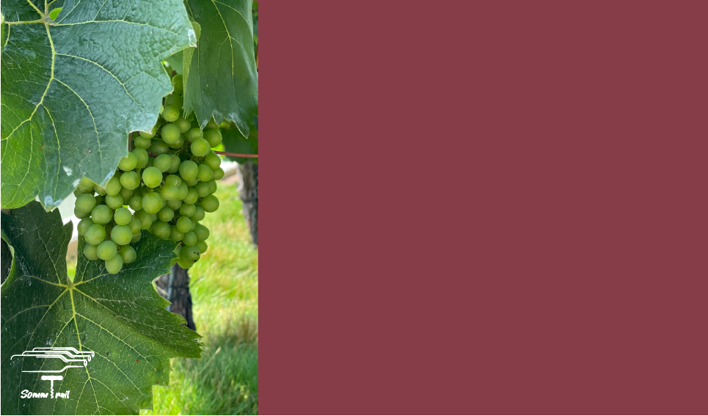
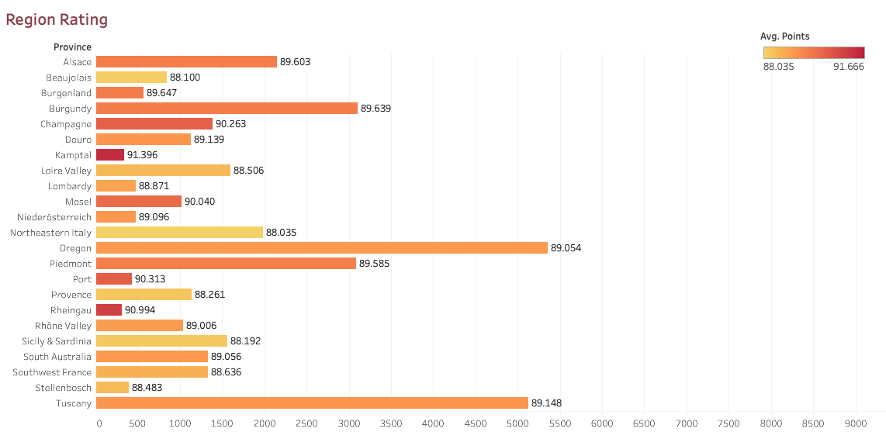
Then look for the Region…

Slide 14
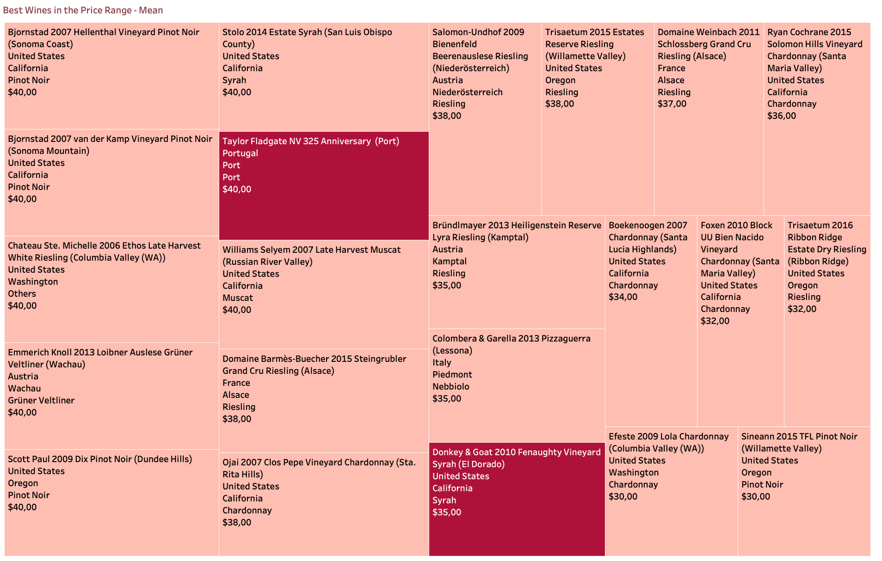
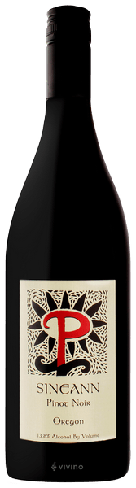
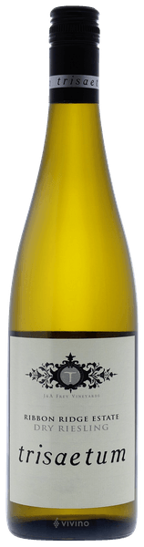
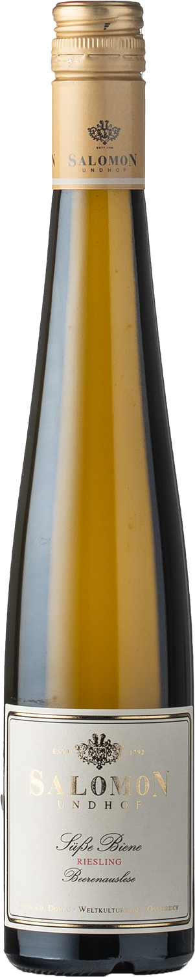
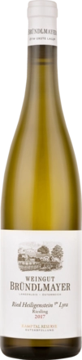
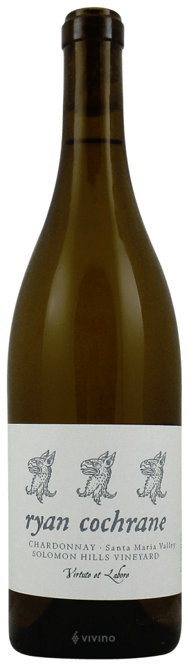
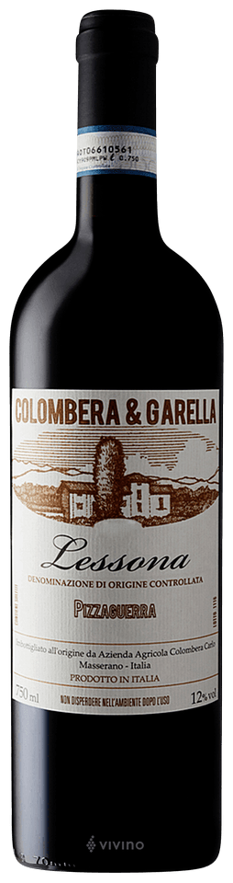
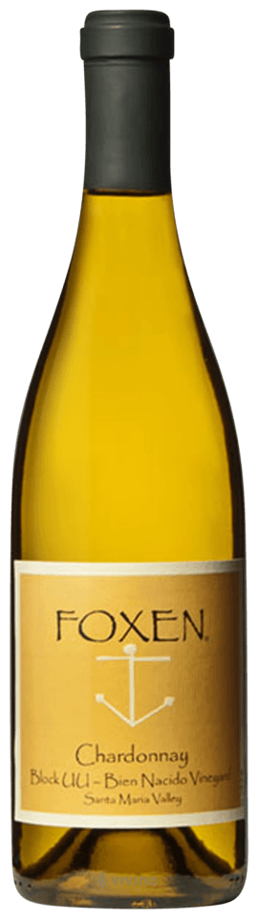
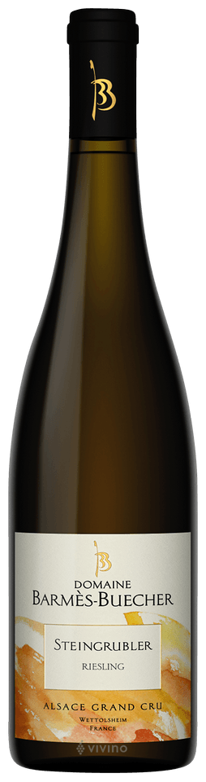
Best Wines in the Range of Price

Slide 15
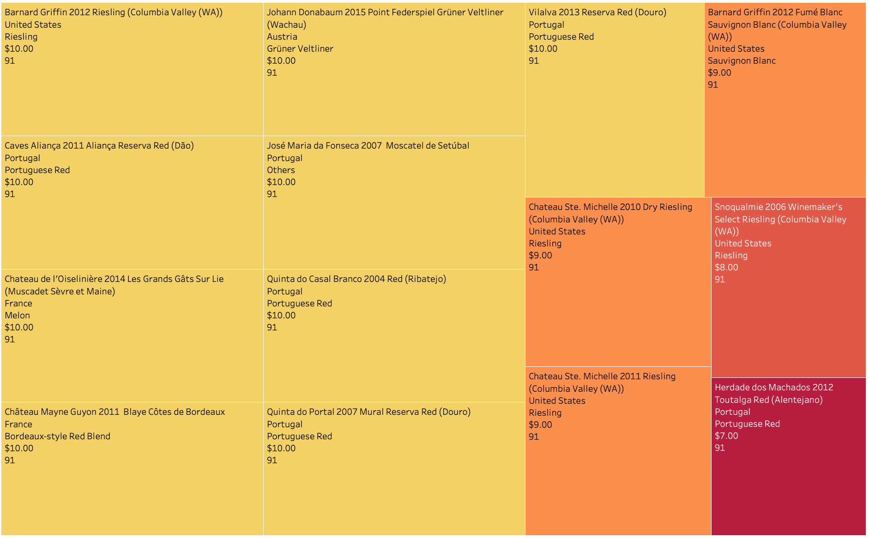
Best Wines under $10

Slide 16
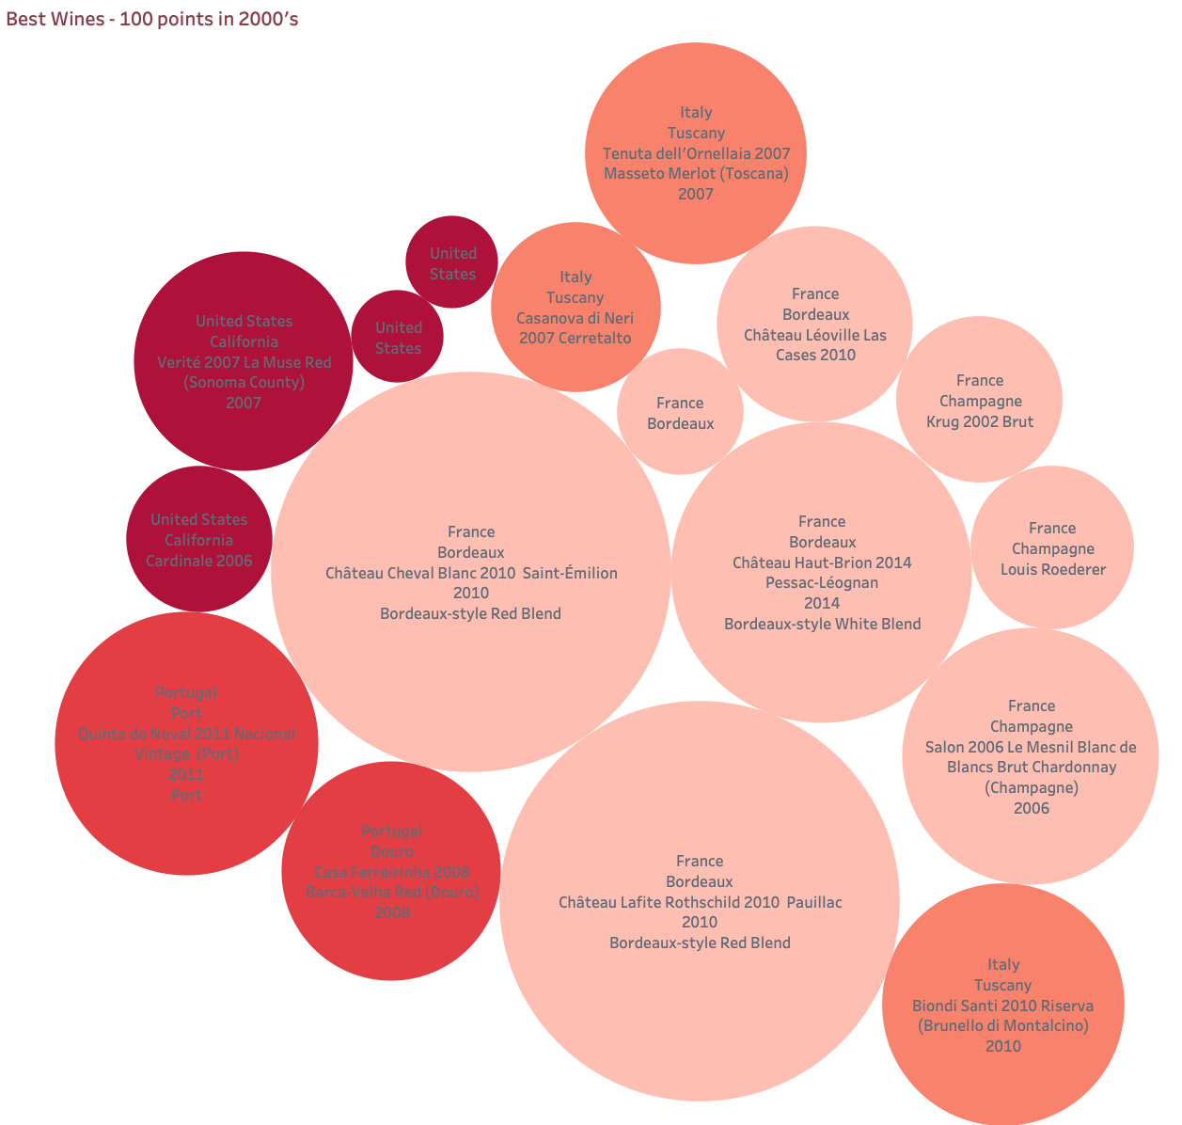
Best Wines?

Slide 17
References
Data Sets
https://www.kaggle.com/zynicide/wine-reviews
https://www.oiv.int/
https://economics.adelaide.edu.au/wine-economics/databases#database-of-regional-national-and-global-winegrape-bearing-areas-by-variety-1960-to-2016
https://data.world/food/wine-quality
Wine Big Numbers
https://www.winecountry.com/blog/wine-basics-by-the-numbers/
Wines
https://www.vivino.com/DE/pt/donkey-and-goat-fenaughty-vineyard-syrah/w/1961343?year=2010#all_reviews
https://www.winemag.com/buying-guide/donkey-goat-2010-fenaughty-vineyard-shiraz-syrah-syrah-sierra-foothills-el-dorado/
https://www.vinatis.de/id-22339-chateau-cheval-blanc-2010-saint-emilion-grand-cru-1er-grand-cru-classe-a?r=googlemerchant_de&ids=smart-shopping-vins&at_medium=Acquiz&at_campaign=googlemerchant_de&at_creation=SEM&at_variant=smart-shopping-vins&gclid=Cj0KCQjwm9yJBhDTARIsABKIcGZKQemCrjlV8BFEBHwUUTmV758kGLrK9XZ4lTzEtHrLVrbW-snfvDUaAt1NEALw_wcB

